Slide 1


CompSci club
Practice with loops
Just like conditionals, today is dedicated to practice with loops and solidifying this topic!

Slide 2

Our person of the day!
Seamus Blackley
In align with our warm-up for today and the celebration of the 20th anniversary of the game console, we give homage to Blackley, the co-creator of Xbox
Prior to working at Microsoft, Blackley worked at Dreamworks Interactive, which would later be acquired by EA and become EA Los Angeles
Fun Fact: EA Los Angeles would develop the Medal of Honor franchise, which would lay the foundation for the Call of Duty franchise
Blackley got the idea for the Xbox on a flight from Boston to Seattle, and when they proposed it to Bill Gates, he approved it
Blackley would leave Microsoft a year after the Xbox was released, but would stay in the video game industry
Currently he is heading a tech startup focused on hologram games
Father of Xbox

Slide 3


Roadmap for Today
Review of Loops
Just a quick review of what we covered last week and a reminder of what loops are!
Practice with Loops
We have quite a bit practice, from easier practice to some substantial programs!

Slide 4
Just the same slides from last week!
A review of
Loops

Slide 5
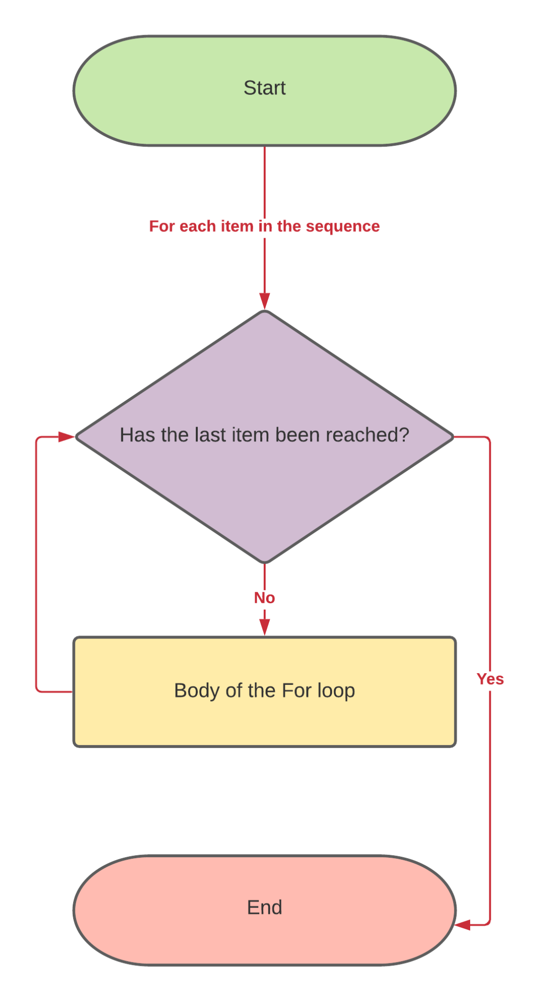
For Loops
For loops are a type of loop that runs until we reach the last item in a sequence, such as a list or string
This process of iterating over a sequence is called a traversal
Because loops and tuples have defined start and end points, for loops are useful when you know how many times you want to iterate over something
If you want to loop over something, say 9 times, you can use the range() function with a for loop
The range takes in a sequence of numbers separated by a comma (and an optional step size)
It is exclusive of the last number
range(0,10) - Generate numbers 1-9
range(0,,10,2) - Print even numbers 0-9

Slide 6
While Loops
The while loop is another type of loop, but it differs from a for loop in that it checks for a condition is true before each run
While loops keep on checking if that condition is True, and when that condition isn’t true, it stops looping
You can see this can be dangerous if our condition is never false
You can potentially have a loop that just runs forever, and it can maybe even crash your computer
In our IDE it isn’t too much of a deal because we don’t have a lot of resources or doing too labor intensive operations
Remember to be careful still!

Slide 7
We will do a few examples together and then it will be your turn!
Now, for some
Loop Practice

Slide 8
In Person Practice
Exercise One:
Let’s create a program that acts like a bouncer to our club
First, create a list with all of the members of our club
Then, using a while loop, keep on asking the user for a name until they pass in a name in the list you just created
Make sure to print something out if they are not allowed!
Exercise Two:
Look in the speaker notes for a complicated looking list of the most popular TV shows right now
Don’t fret! Break it into parts:
Each item in the list is a dictionary
Each dictionary has three keys: a name, a rating and a channel
Just print out a nice statement with the name of the show with its rating and channel
Notes:
shows = [{"name": "Squid Game", "rating": 8.1, "channel": "Netflix"}, {"name": "You", "rating": 7.7, "channel": "Netflix"}, {"name": "The Good Doctor", "rating": 8.1, "channel": "ABC"}, {"name": "Game of Thrones", "rating": 9.2, "channel": "HBO"}]

Slide 9
Your Practice!
Exercise One:
Check the Speaker Notes for 3 lists for this exercise
Each one of these lists has a country, their capital and their population at the same index
Print out the capitol and the corresponding country
If the population is less than 1 million, tell us it is a small capital
If the population is less than 10 million, tell us it is a medium capital
Else, it is a large capitol
Print all of that out (including what the population actually is)
Exercise Two:
Create a loop that asks the user for an amount of Thanksgiving dishes
Once they specify an amount, ask them for the amount of calories and grams of sugar in each dish
Print out the total amount of calories and grams of sugar at the end!
Notes:
capital = ["Monaco","Brussels","Lisbon","Kathmandu","Tehran","Kinshasa","Beijing"]
country = ["Monaco","Belgium","Portugal","Nepal","Iran","DRC","China"]
population = [.03, .15, .56,1, 8.69, 12.69, 21.54 ]

Slide 10
You are now ready for your first project in the next meeting!
Thank you!
That is all we have for today!

